Slide 1


Cold Diffusion: Inverting Arbitrary Image Transforms Without Noise
Paper by Arpit Bansal, Eitan Borgnia, Hong-Min Chu, Jie S. Li, Hamid Kazemi, Furong Huang, Micah Goldblum, Jonas Geiping, Tom Goldstein
Presented by Monseej Purkayastha

Slide 2
01
Diffusion and
Generation

Slide 3
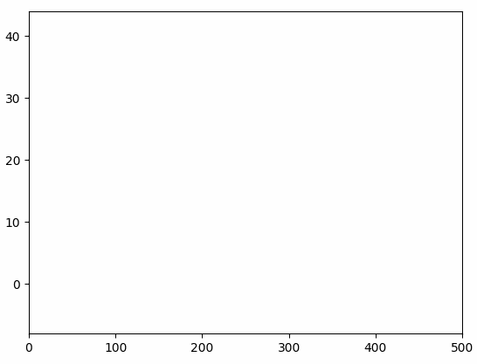
Diffusion Models
Simulates a random walk
Notes:
Reverse process that learns to generate data by restoration using a restoration operator R that approximately inverts D.

Slide 4

Generation
Image synthesis/restoration
Image credit: r/OpenAI (Reddit)
Notes:
Reverse process that learns to generate data by restoration using a restoration operator R that approximately inverts D.

Slide 5

Generation
Image synthesis/restoration
Video generation
Video credit: Yang Song’s talk Diffusion and Score-Based Generative Models (youtube.com)
Notes:
Reverse process that learns to generate data by restoration using a restoration operator R that approximately inverts D.

Slide 6
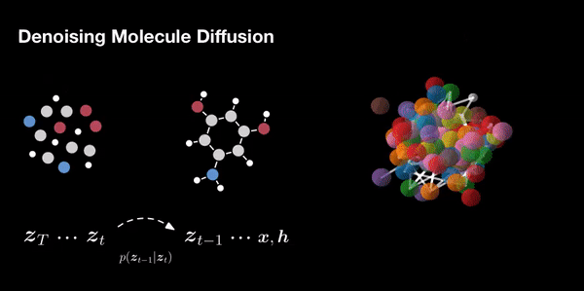
Generation
Image synthesis/restoration
Video generation
Molecule generation
Video credit: Equivariant Diffusion for Molecule Generation in 3D, Hoogeboom et al., ICML 2022 (Gif taken from Twitter (X))
Notes:
Reverse process that learns to generate data by restoration using a restoration operator R that approximately inverts D.

Slide 7
02
Recap on Diffusion Principles

Slide 8


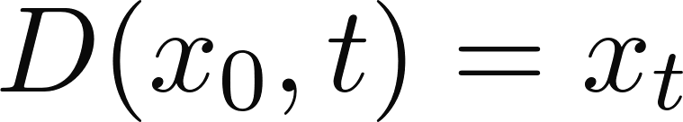


Recap of Diffusion
process
Forward degradation process ( )
:
Notes:
Reverse process that learns to generate data by restoration using a restoration operator R that approximately inverts D.

Slide 9

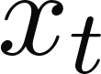
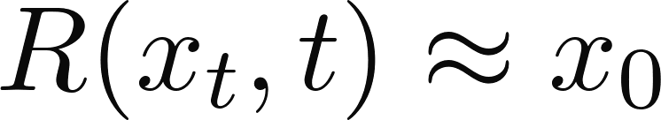

Recap of Diffusion
process
Forward degradation process ( )
Reverse restoration process ( )
:
:
Image credit: Denoising Diffusion-based Generative Modelling: Foundations and Applications, Vahdat et al.,CVPR 2022 Tutorial
Notes:
Reverse process that learns to generate data by restoration using a restoration operator R that approximately inverts D.

Slide 10

Recap of Diffusion
process
The diffused state
Image credit: Denoising Diffusion-based Generative Modelling: Foundations and Applications, Vahdat et al.,CVPR 2022 Tutorial
Notes:
Need some changes here

Slide 11
Recap of Diffusion
process
The diffused state
Can be anything!!
Notes:
Need some changes here

Slide 12
The Big Question
Is noise really that important??
Notes:
Add annotations to the image here

Slide 13
The Big Question
Is noise really that important??
How about something else??
Notes:
Add annotations to the image here

Slide 14
03
Cold
Diffusion
Hence the name

Slide 15
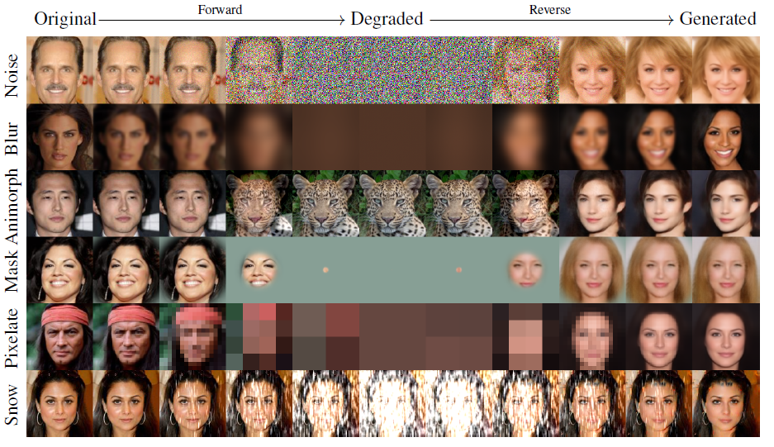
Cold Diffusion
Image credit: Cold Diffusion: Inverting Arbitrary Image Transforms without Noise, Bansal et al., NeurIPS 2023
Notes:
Add an image here, make it intuitive

Slide 16
04
Procedure
Training and Sampling

Slide 17
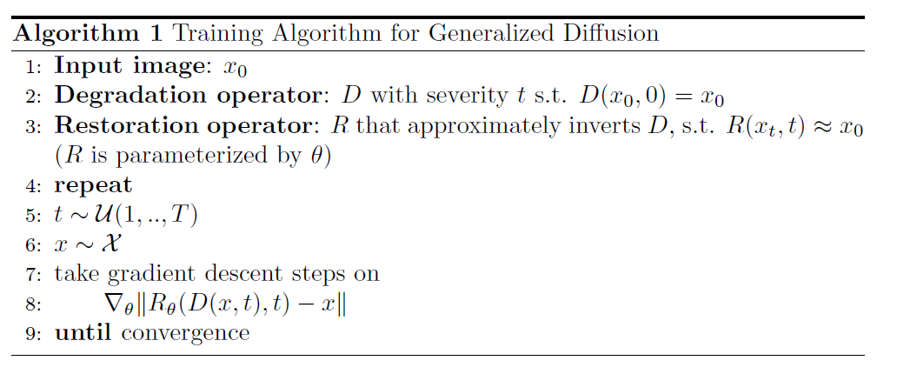
Training
Similar to DDPM by Ho, et al.
Notes:
Add an image here, make it intuitive

Slide 18
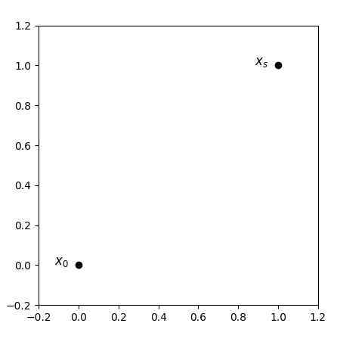
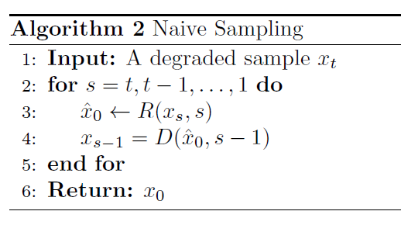
Sampling/Generation
Alternates between D and R
Notes:
Add an image here, make it intuitive

Slide 19
Sampling/Generation
Alternates between D and R
Notes:
Add an image here, make it intuitive

Slide 20
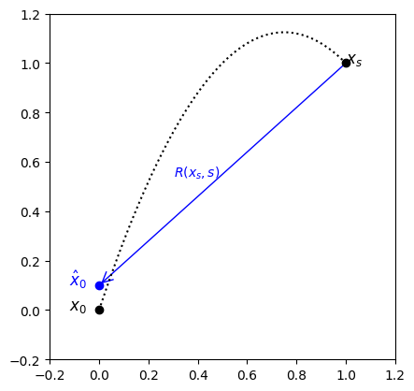
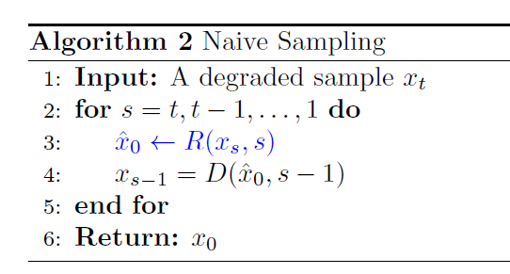
Sampling/Generation
Alternates between D and R
Notes:
Add an image here, make it intuitive

Slide 21
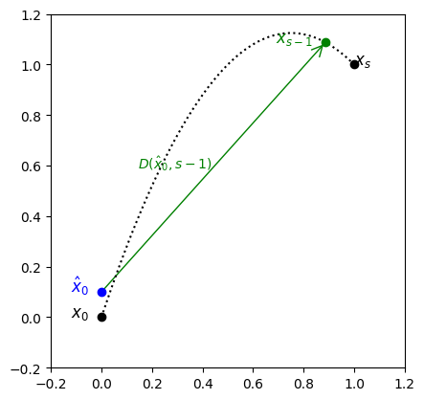
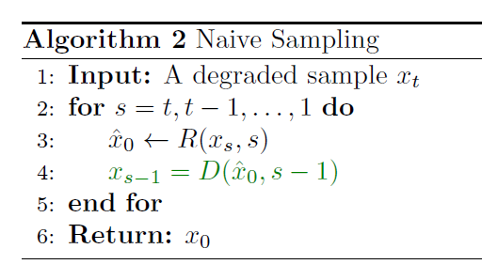
Sampling/Generation
Alternates between D and R
Notes:
Add an image here, make it intuitive

Slide 22

Sampling/Generation
Noise
Notes:
Add an image here, make it intuitive

Slide 23

Sampling/Generation
Noise
Blur, down-sampling, masking
Notes:
Add an image here, make it intuitive

Slide 24
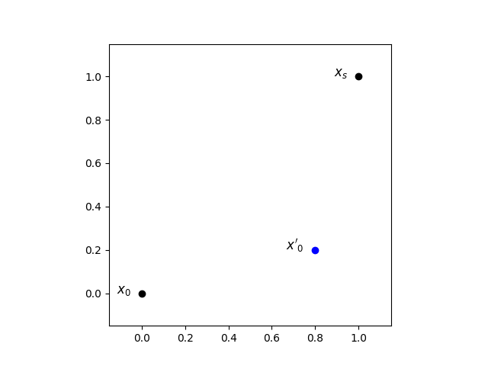
Sampling/Generation
Noise
Blur, down-sampling, masking
Notes:
Add an image here, make it intuitive

Slide 25
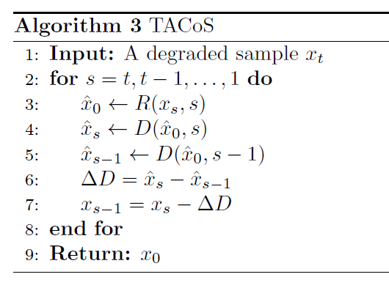
TACoS
Transformation Agnostic Cold Sampling (TACoS)
Notes:
Add an image here, make it intuitive

Slide 26
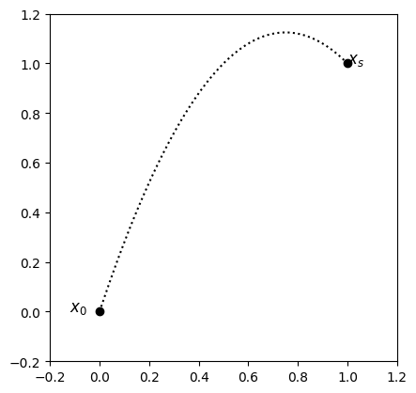
TACoS
Transformation Agnostic Cold Sampling (TACoS)
Notes:
Add an image here, make it intuitive

Slide 27
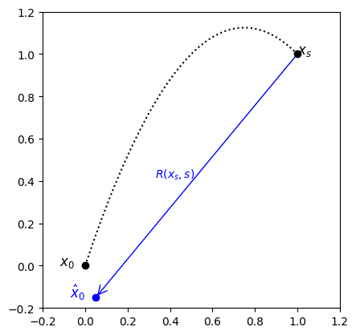
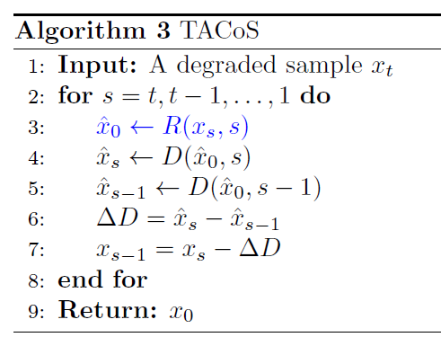
TACoS
Transformation Agnostic Cold Sampling (TACoS)
Notes:
Add an image here, make it intuitive

Slide 28
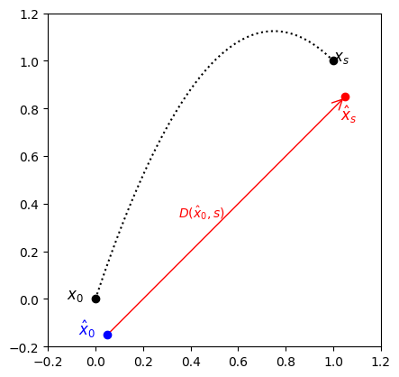
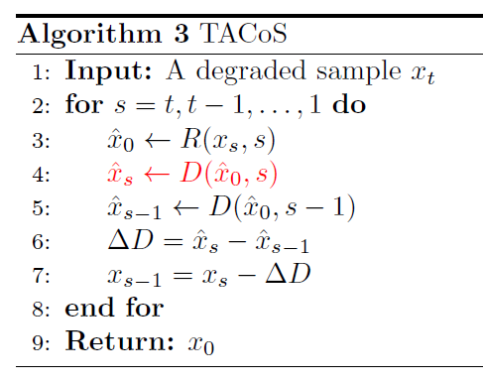
TACoS
Transformation Agnostic Cold Sampling (TACoS)
Notes:
Add an image here, make it intuitive

Slide 29
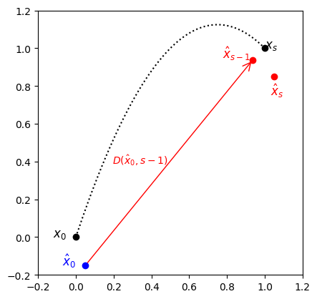
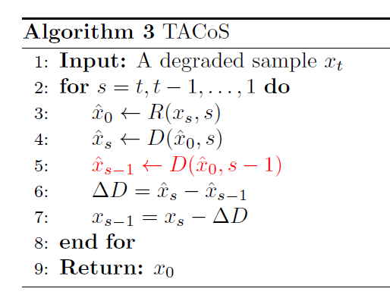
TACoS
Transformation Agnostic Cold Sampling (TACoS)
Notes:
Add an image here, make it intuitive

Slide 30
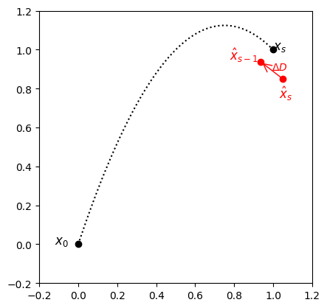
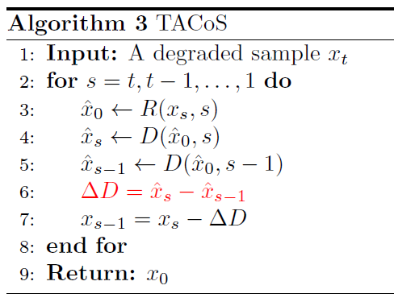
TACoS
Transformation Agnostic Cold Sampling (TACoS)
Notes:
Add an image here, make it intuitive

Slide 31
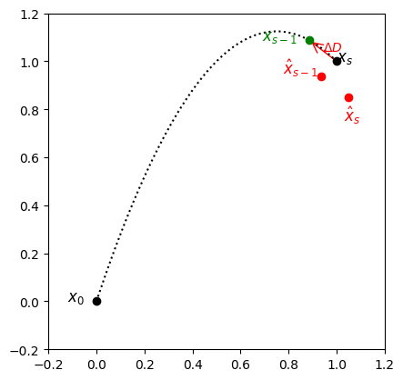
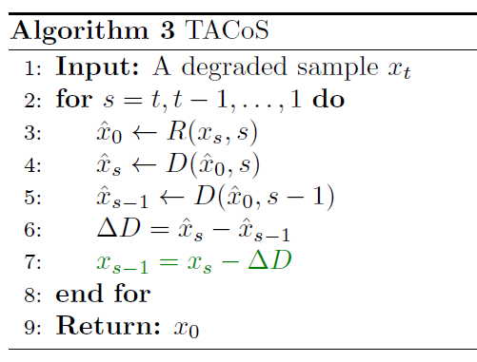
TACoS
Transformation Agnostic Cold Sampling (TACoS)
Notes:
Add an image here, make it intuitive

Slide 32
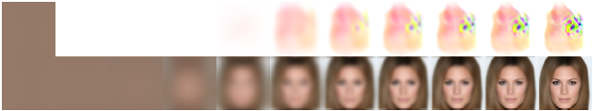
Advantages
Much more stable
Better reconstructions
Image credit: Cold Diffusion: Inverting Arbitrary Image Transforms without Noise, Bansal et al., NeurIPS 2023
Notes:
Add an image here, make it intuitive

Slide 33
05
Experiments
and Examples
Conditional Generation
Cold Generation

Slide 34
Dataset
MNIST
CIFAR-10
CelebA
Notes:
Add an image here, make it intuitive

Slide 35
Metrics
Fréchet Inception Distance (FID)
Structural Similarity Index Measure (SSIM)
Root Mean Squared Error (RMSE)
Notes:
Add an image here, make it intuitive

Slide 36
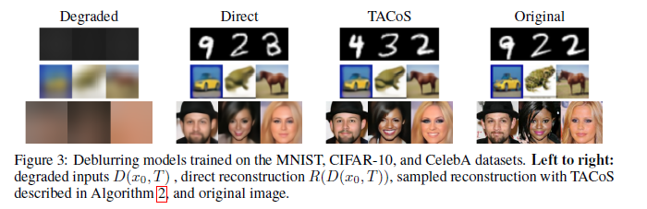
Conditional Generation
(Blur)
Gaussian blur
Image credit: Cold Diffusion: Inverting Arbitrary Image Transforms without Noise, Bansal et al., NeurIPS 2023
Notes:
Add an image here, make it intuitive

Slide 37
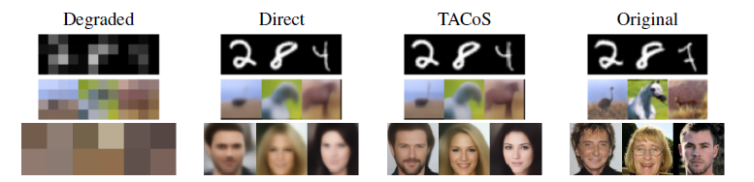
Conditional Generation
(Down-sampling)
Gaussian Pyramid
Image credit: Cold Diffusion: Inverting Arbitrary Image Transforms without Noise, Bansal et al., NeurIPS 2023
Notes:
Add an image here, make it intuitive

Slide 38
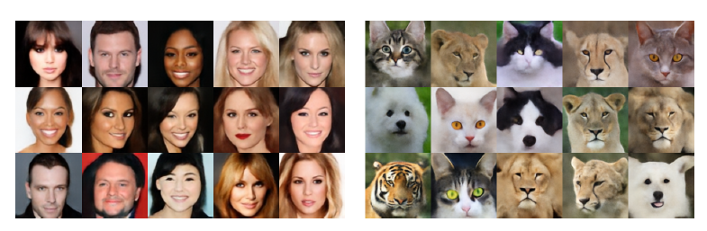
Cold Generation
(Blur)
Noise needed
Image credit: Cold Diffusion: Inverting Arbitrary Image Transforms without Noise, Bansal et al., NeurIPS 2023
Notes:
Add an image here, make it intuitive

Slide 39
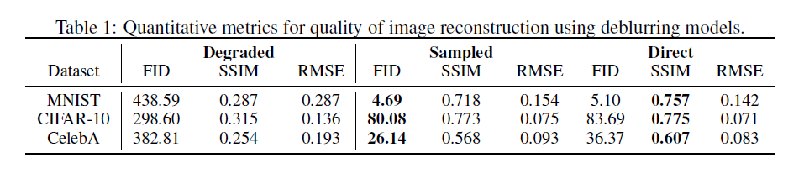
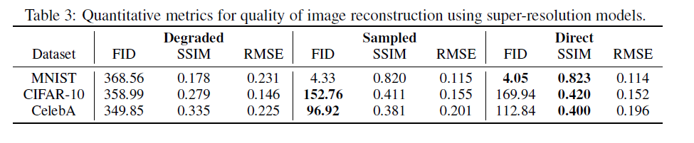
Results (Summary)
Gaussian blur
Downsampling
Notes:
Add an image here, make it intuitive

Slide 40
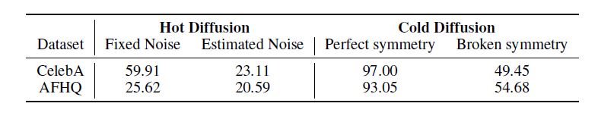
Results (Summary)
Cold Generation: Blur
Notes:
Add an image here, make it intuitive

Slide 41
06
Further
work
Improvements
Open Problems

Slide 42
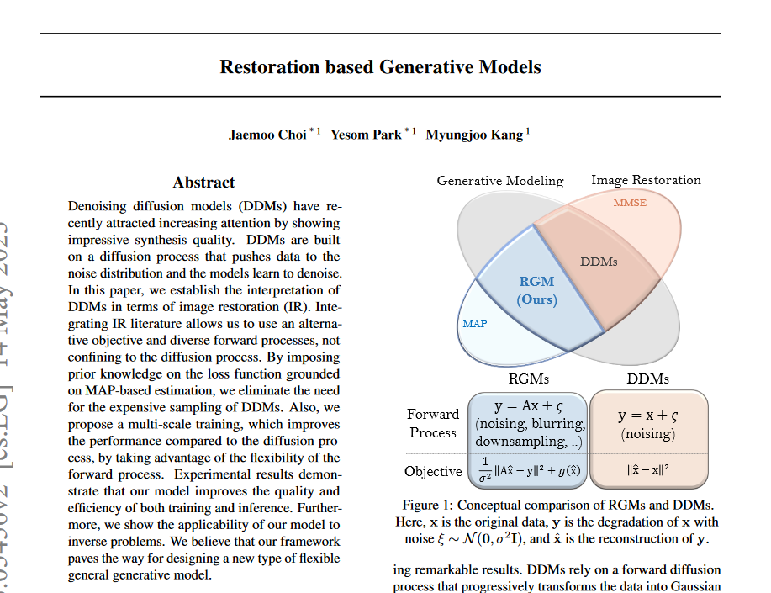
Improvements
Restorations not faithful
Reconstruction based Generative Models by Choi et al. (2023)
Notes:
Add an image here, make it intuitive

Slide 43
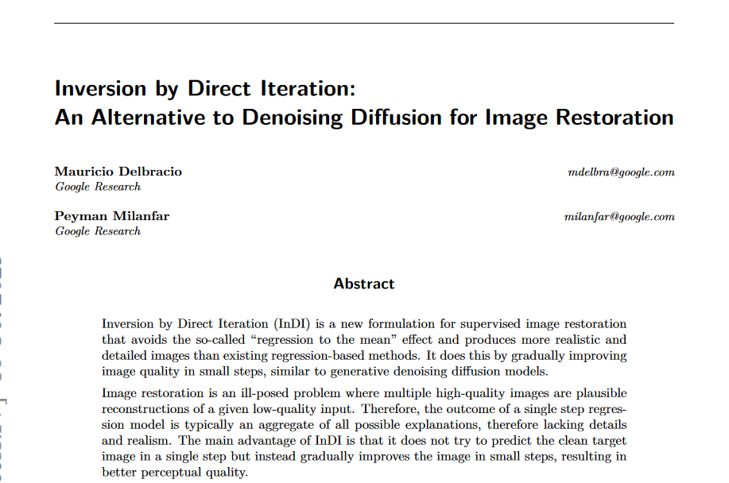
Improvements
Restorations not faithful
Reconstruction based Generative Models by Choi et al.
Knowledge of D required
InDI by Delbracio et al.
Notes:
Add an image here, make it intuitive

Slide 44
Open questions
Cannot remove noise completely??
Efficiency??
Robustness??
Notes:
Add an image here, make it intuitive

Slide 45
Summary
Noise is still necessary
We can use other degradations
TACoS gives better reconstructions

Slide 46
“
Questions

Slide 47
Thank you!
Please keep this slide for attribution

Slide 48
References
Bansal, A., Borgnia, E., Chu, H., Li, J., Kazemi, H., Huang, F., Goldblum, M., Geiping, J., & Goldstein, T. (2023). Cold Diffusion: Inverting Arbitrary Image Transforms Without Noise. Neural Information Processing Systems, 32, 2023.
Delbracio, M., & Milanfar, P. (2023). Inversion by Direct Iteration: An Alternative to Denoising Diffusion for Image Restoration.
Choi, J., Park, Y., & Kang, M. (2023). Restoration based Generative Models.
Ho, J., Jain, A., & Abbeel, P. (2020). Denoising Diffusion Probabilistic Models. Advances in
Neural Information Processing Systems, 32, 2020.
Dhariwal, P., & Nichol, A. (2021). Diffusion Models Beat GANs on Image Synthesis. volume 34, 2021.
Song,Y., & Ermon, S (2019). Generative modeling by estimating gradients of the data distribution.Advances in Neural Information Processing Systems, 32, 2019.

